Slide 1
C# Fundamentals

Slide 2
What is C#?
It is an object-oriented programming language provided by Microsoft that runs on .Net Framework.

Slide 3
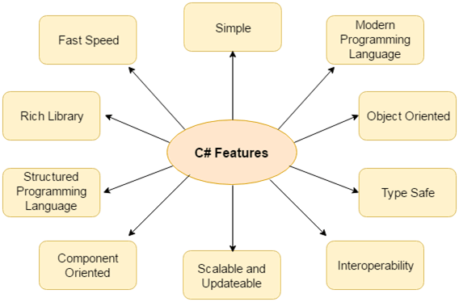

Slide 4
Java Vs C#
Java | C#
Java is a high level, robust, secured and object-oriented programming language developed by Oracle. | C# is an object-oriented programming language developed by Microsoft that runs on .Net Framework.
Java programming language is designed to be run on a Java platform, by the help of Java Runtime Environment (JRE). | C# programming language is designed to be run on the Common Language Runtime (CLR).
In java, built-in data types that are passed by value are called primitive types. | In C#, built-in data types that are passed by value are called simple types.
Arrays in Java are direct specialization of Object. | Arrays in C# are specialization of System.
Java doesn't support goto statement. | C# supports goto statement.
Java doesn't support structures and unions. | C# supports structures and unions.
Java supports checked exception and unchecked exception. | C# supports unchecked exception.

Slide 5
C# Variables
A variable is a name of memory location. It is used to store data. Its value can be changed and it can be reused many times.
Variable Type | Example
Decimal types | decimal
Boolean types | True or false value, as assigned
Integral types | int, char, byte, short, long
Floating point types | float and double
Nullable types | Nullable data types

Slide 6
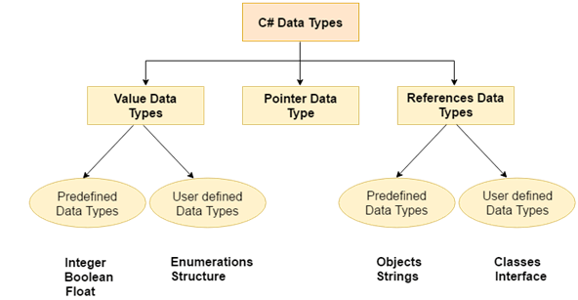
C# datatypes

Slide 7
C# Operators
Arithmetic Operators
Relational Operators
Logical Operators
Bitwise Operators
Assignment Operators
Unary Operators
Ternary Operators

Slide 8
C# Keywords
byte char checked class continue decimal private
public return explicit extern false finally fixed float for
foreach implicit in unchecked using unsafe virtual void null object operator out
default delegate do double else enum event
sealed short sizeof static string struct
switch this throw true try abstract base as bool break catch case volatile while

Slide 9
C# Control Statements
In C# programming, the if statement is used to test the condition. There are various types of if statements in C#.
if statement
if-else statement
nested if statement

Slide 10
C# Switch
The C# switch statement executes one statement from multiple conditions.

Slide 11
C# For Loop
The C# for loop is used to iterate a part of the program several times. If the number of iteration is fixed, it is recommended to use for loop than while or do-while loops.

Slide 12
C# While Loop
In C#, while loop is used to iterate a part of the program several times. If the number of iteration is not fixed, it is recommended to use while loop than for loop.

Slide 13
C# Do-While Loop
The C# do-while loop is used to iterate a part of the program several times. If the number of iteration is not fixed and you must have to execute the loop at least once, it is recommended to use do-while loop.
The C# do-while loop is executed at least once because condition is checked after loop body.

Slide 14
C# Goto Statement
The C# goto statement is also known jump statement. It is used to transfer control to the other part of the program. It unconditionally jumps to the specified label.
It can be used to transfer control from deeply nested loop or switch case label.
Currently, it is avoided to use goto statement in C# because it makes the program complex.

Slide 15
C# Function
Function is a block of code that has a signature. Function is used to execute statements specified in the code block. A function consists of the following components:
Function name: It is a unique name that is used to make Function call.
Return type: It is used to specify the data type of function return value.
Body: It is a block that contains executable statements.

Slide 16
C# Call By Value
In C#, value-type parameters are that pass a copy of original value to the function rather than reference. It does not modify the original value. A change made in passed value does not alter the actual value.

Slide 17
C# Call By Reference
C# provides a ref keyword to pass argument as reference-type. It passes reference of arguments to the function rather than copy of original value. The changes in passed values are permanent and modify the original variable value.

Slide 18
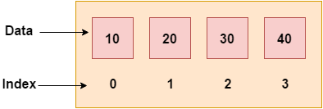
C# Arrays
Like other programming languages, array in C# is a group of similar types of elements that have contiguous memory location. In C#, array is an object of base type System.Array. In C#, array index starts from 0. We can store only fixed set of elements in C# array.

Slide 19
Advantages and Disadvantages of Arrays
Advantages of C# Array
Code Optimization (less code)
Random Access
Easy to traverse data
Easy to manipulate data
Easy to sort data etc.
Disadvantages of C# Array
Fixed size

Slide 20
Types of Arrays
Single Dimensional Array
Multidimensional Array
Jagged Array

Slide 21
Multidimensional Array
The multidimensional array is also known as rectangular arrays in C#. It can be two dimensional or three dimensional. The data is stored in tabular form (row * column) which is also known as matrix.
To create multidimensional array, we need to use comma inside the square brackets.

Slide 22
Jagged Arrays
In C#, jagged array is also known as "array of arrays" because its elements are arrays. The element size of jagged array can be different.

Slide 23
C# Array class
C# provides an Array class to deal with array related operations. It provides methods for creating, manipulating, searching, and sorting elements of an array. This class works as the base class for all arrays in the .NET programming environment.

Slide 24
C# Constructor
In C#, constructor is a special method which is invoked automatically at the time of object creation. It is used to initialize the data members of new object generally. The constructor in C# has the same name as class or struct.
There can be two types of constructors in C#.
Default constructor
Parameterized constructor

Slide 25
C# Destructor
A destructor works opposite to constructor, It destructs the objects of classes. It can be defined only once in a class. Like constructors, it is invoked automatically.
C# destructor cannot have parameters.

Slide 26
C# this
In C# programming, “this” is a keyword that refers to the current instance of the class. There can be 3 main usage of this keyword in C#.
It can be used to refer current class instance variable. It is used if field names (instance variables) and parameter names are same, that is why both can be distinguish easily.
It can be used to pass current object as a parameter to another method.
It can be used to declare indexers.

Slide 27
C# static
In C#, static is a keyword or modifier that belongs to the type not instance. So instance is not required to access the static members. In C#, static can be field, method, constructor, class, properties, operator and event.
Advantage of C# static keyword:
Memory efficient: Now we don't need to create instance for accessing the static members, so it saves memory.

Slide 28
C# Structs
In C#, classes and structs are blueprints that are used to create instance of a class. Structs are used for lightweight objects such as Color, Rectangle, Point etc.

Slide 29
C# Enum
Enum in C# is also known as enumeration. It is used to store a set of named constants such as season, days, month, size etc. The enum constants are also known as enumerators. Enum in C# can be declared within or outside class and structs.
Enum constants has default values which starts from 0 and incremented to one by one. But we can change the default value.

Slide 30
C# Namespaces
Namespaces in C# are used to organize too many classes so that it can be easy to handle the application.
In a simple C# program, we use System.Console where System is the namespace and Console is the class. To access the class of a namespace, we need to use namespacename.classname. We can use using keyword so that we don't have to use complete name all the time.

Slide 31
C# Strings
In C#, string is an object of System.String class that represent sequence of characters. We can perform many operations on strings such as concatenation, comparison, getting substring, search, trim, replacement etc.

Slide 32
C# Exception Handling
Exception Handling in C# is a process to handle runtime errors. We perform exception handling so that normal flow of the application can be maintained even after runtime errors.
In C#, exception is an event or object which is thrown at runtime. All exceptions are derived from System.Exception class. It is a runtime error which can be handled. If we don't handle the exception, it prints exception message and terminates the program.

Slide 33
Checked and Unchecked Exceptions
C# provides checked and unchecked keyword to handle integral type exceptions. Checked and unchecked keywords specify checked context and unchecked context respectively. In checked context, arithmetic overflow raises an exception whereas, in an unchecked context, arithmetic overflow is ignored and result is truncated.

